Slide 1
C# and ASP.NET 2.0 Concepts
-Team Arindam

Slide 2
Interfaces and Abstract Classes
-Ashutosh

Slide 3
Interfaces
We create interfaces using Interface Keyword. Just like classes interfaces also contains properties, methods, delegates or events, but only declarations and no implementations.
It is a compile time error to provide implementations in any interface.
Public by default , they don’t allow explicit access modifiers.
Interfaces cannot contain fields.
If a class or a struct inherits from an interface, it must provide implementations for all interface members. Otherwise, we get a compiler error.
A class or struct can inherit from more than one interface at the same time, but whereas, a class cannot inherit from more than one class at the same time.
Interfaces can inherit from other interfaces. A Class that inherits this interface must provide implementation for all interface members in the entire interface inheritance chain.
We cannot create an instance of an interface, but an interface reference variable can point to a derived class object.

Slide 4
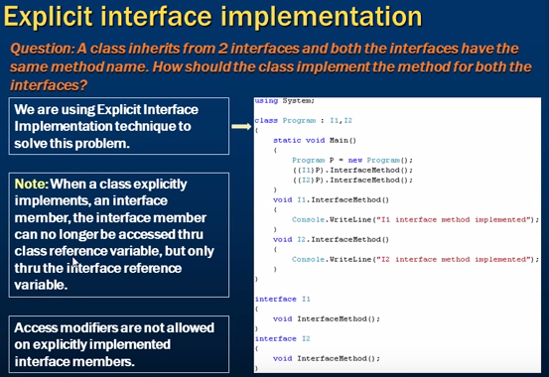

Slide 5
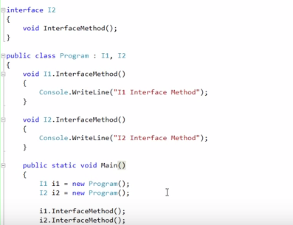

Slide 6
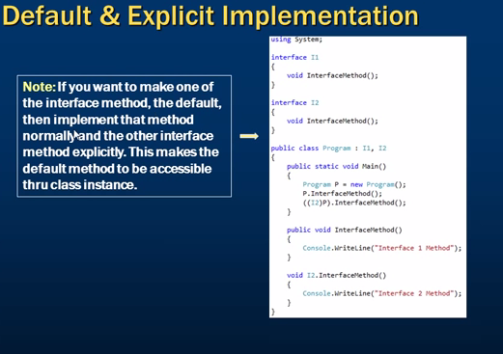

Slide 7
Abstract Classes
Abstract keyword is used to create abstract classes.
An abstract class in incomplete and hence cannot be instantiated.
An abstract class only be used as a base class.
An abstract class cannot be sealed.
An abstract class may contain an abstract member(methods, properties, indexers, events) but not mandatory.
A non-abstract class derived from an abstract class must provide implementations for all inherited members.
If a class inherits an abstract class, then two options are available:
1. Provide implementation for all abstract class members inherited from the base abstract class.
2. If the class does not wish to provide implementation for all the abstract members inherited from the abstract class, then the class has to be marked as the abstract class.

Slide 8
Difference between abstract classes and interfaces
Abstract classes can have implementation for some of its members(methods),But interfaces cannot have implementation for any of its members.
Interfaces cannot have fields but abstract classes can have fields.
An interface can inherit only from another interface and cannot inherit from an abstract class, whereas an abstract class can inherit from another abstract class as well as interface.
An abstract class can inherit from multiple interfaces at the same time, however a class cannot inherit from multiple classes at the same time.
Abstract class members can have access modifiers but interface members cannot have access modifiers since they are public by default.

Slide 9
Use an abstract class
When creating a class library which will be widely distributed or reused—especially to clients, use an abstract class in preference to an interface; because, it simplifies versioning. This is the practice used by the Microsoft team which developed the Base Class Library. (COM was designed around interfaces.)
Use an abstract class to define a common base class for a family of types. Use an abstract class to provide default behavior. Subclass only a base class in a hierarchy to which the class logically belongs.

Slide 10
Use an interface
When creating a standalone project which can be changed at will, use an interface in preference to an abstract class; because, it offers more design flexibility.
Use interfaces to introduce polymorphic behavior without subclassing and to model multiple inheritance—allowing a specific type to support numerous behaviors.
A well-designed interface defines a very specific range of functionality. Split up interfaces that contain unrelated functionality.

Slide 11
Polymorphism
Polymorphism means having more than one form. Overloading and overriding are used to implement polymorphism. Polymorphism is classified into compile time polymorphism or early binding or static binding and Runtime polymorphism or late binding or dynamic binding
Overriding - same method names with same arguments and same return types associated in a class and its subclass. Overriding in C# makes use of the "override" keyword. To override a method means to replace it with a new way of handling data.
Overloading - same method name with different arguments, may or may not be same return type written in the same class itself.

Slide 12
Compile time Polymorphism or Early Binding
The polymorphism in which compiler identifies which polymorphic form it has to execute at compile time itself is called as compile time polymorphism or early binding.
Advantage of early binding is execution will be fast. Because everything about the method is known to compiler during compilation itself and disadvantage is lack of flexibility.
Examples of early binding are overloaded methods, overloaded operators and overridden methods that are called directly by using derived objects.

Slide 13
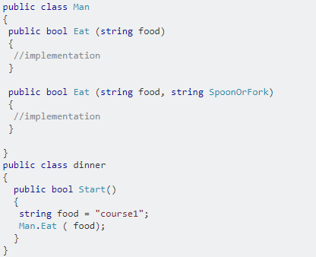
Compile time Polymorphism or Early Binding

Slide 14
Runtime Polymorphism or Late Binding
The polymorphism in which compiler identifies which polymorphic form to execute at runtime but not at compile time is called as runtime polymorphism or late binding.
Advantage of late binding is flexibility and disadvantage is execution will be slow as compiler has to get the information about the method to execute at runtime.
Example of late binding is overridden methods that are called using base class object.

Slide 15
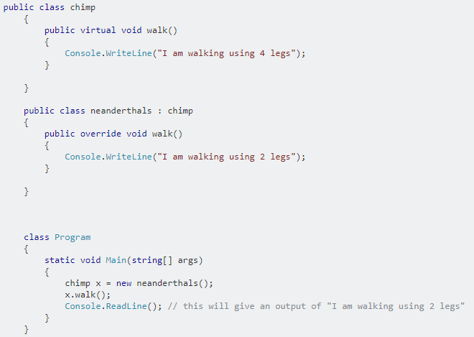
Runtime Polymorphism or Late Binding

Slide 16
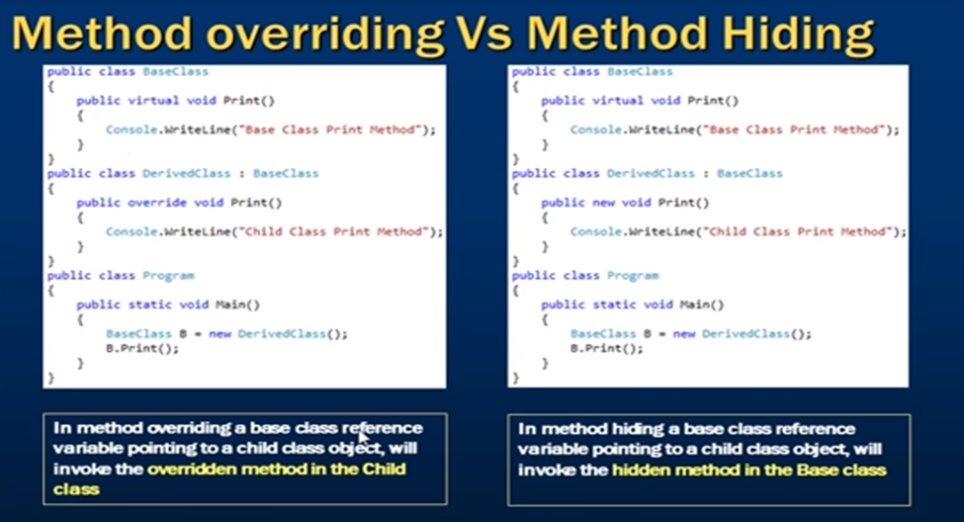

Slide 17
Method Overriding, Overloading and OOPS
-Ishika

Slide 18
Method Overriding
Method overriding in C# is a feature like the virtual function in C++.
Method overriding is a feature that allows you to invoke functions (that have the same signatures) that belong to different classes in the same hierarchy of inheritance using the base class reference.
C# makes use of two keywords: virtual and overrides to accomplish Method overriding.

Slide 19
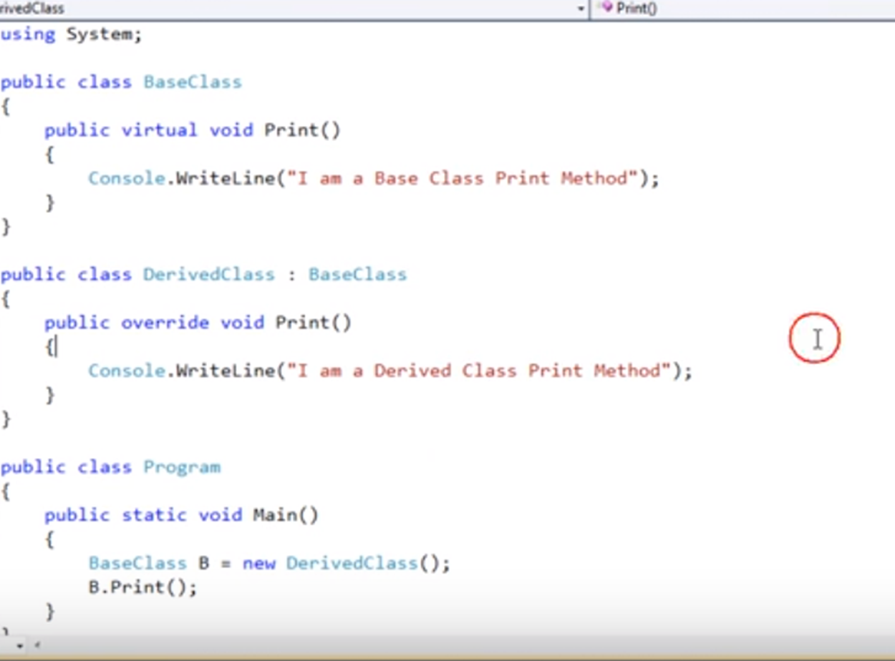

Slide 20
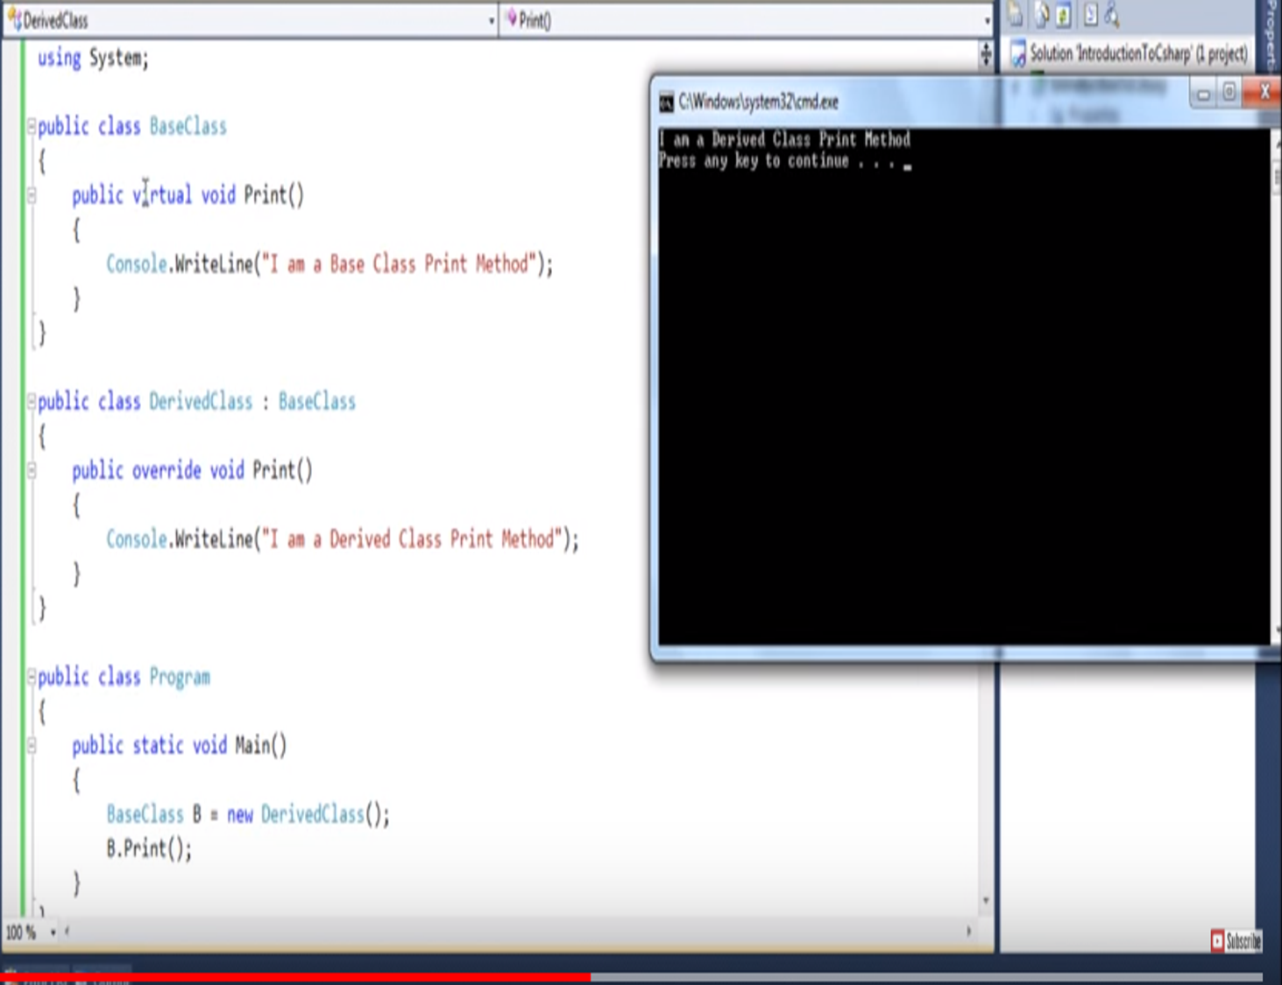

Slide 21
Method Overloading
The process of creating more than one method in a class with same name or creating a method in derived class with same name as a method in base class is called as method overloading.
While overloading methods, a rule to follow is the overloaded methods must differ either in number of arguments they take or the data type of at least one argument.

Slide 22
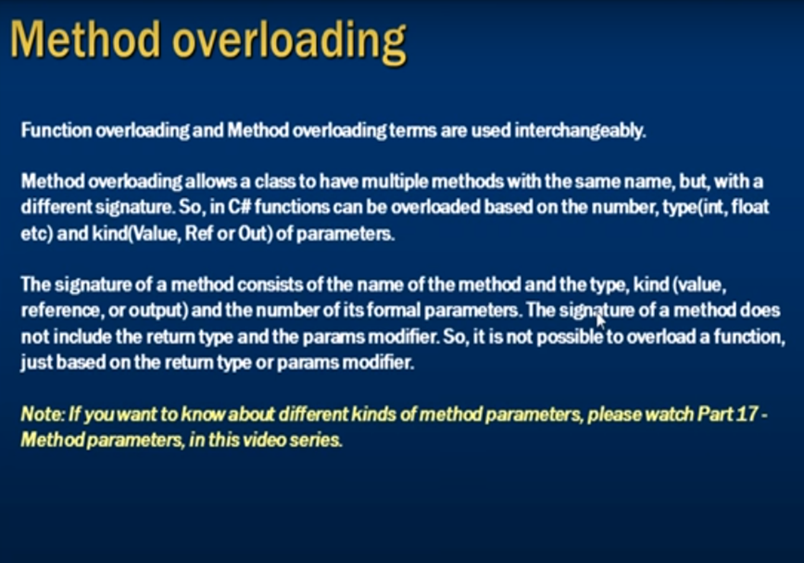

Slide 23
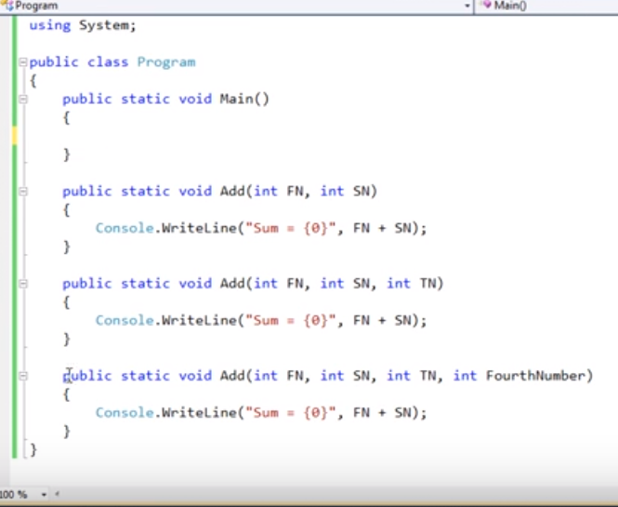

Slide 24
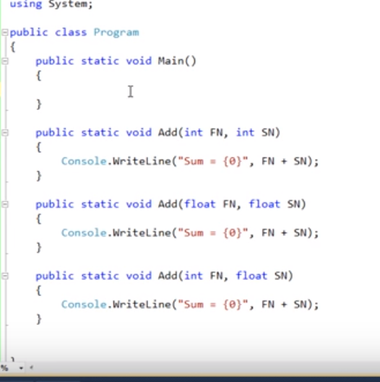

Slide 25
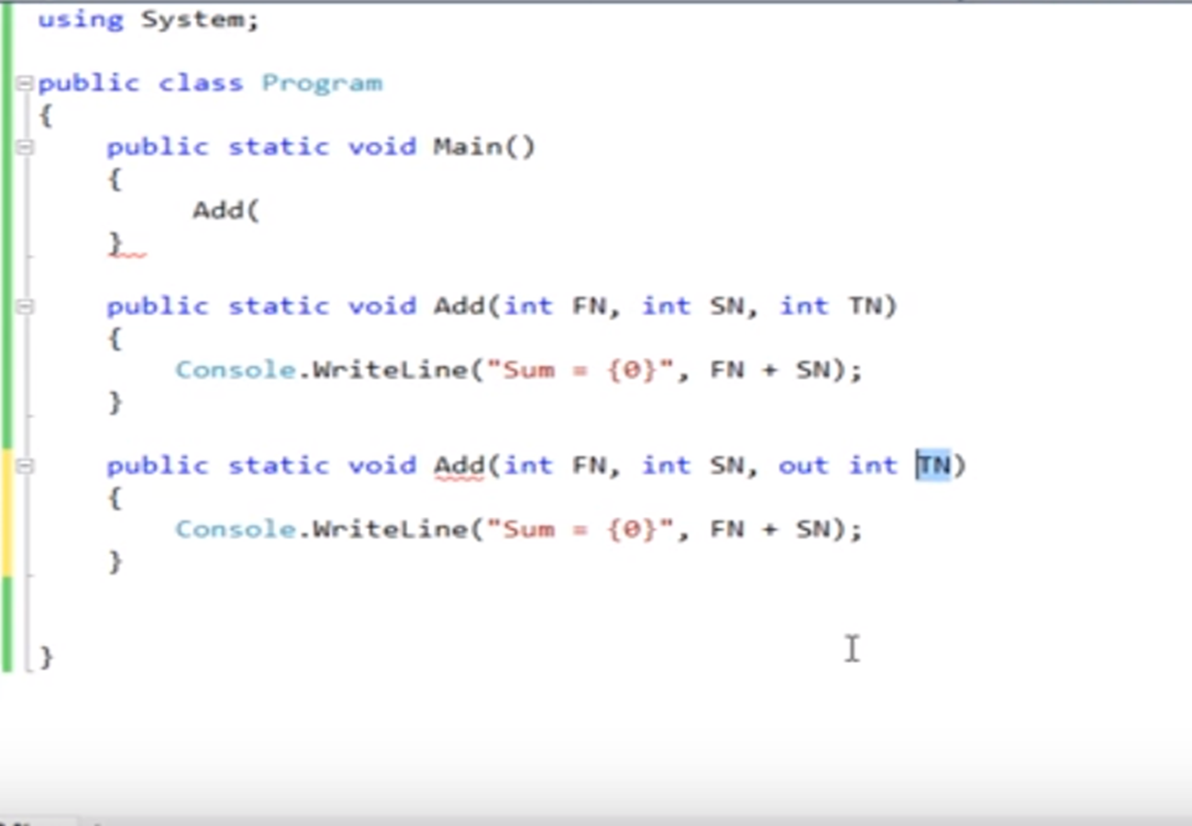

Slide 26
Abstraction
The abstraction is done when we need to only inherit from a certain class, but not need to instantiate objects of that class. In such case the base class can be regarded as "Incomplete". Such classes are known as an “Abstract Base Class”.
An Abstract Base class can not be instantiated; it means the object of that class can not be created.
Class having abstract keyword and having, abstract keyword with some of its methods (not all) is known as an Abstract Base Class
Class having Abstract keyword and having abstract keyword with all of its methods is known as pure Abstract Base Class.
An abstract class holds the methods but the actual implementation of those methods is made in derived class.

Slide 27
The output of this code would be as dog can eat dog can sound
class program { abstract class animal { public abstract void eat(); public void sound() { Console.WriteLine("dog can sound"); } } class dog : animal { public override void eat() { Console.WriteLine("dog can eat"); } } static void Main(string[] args) { dog mydog = new dog(); animal thePet = mydog; thePet.eat(); mydog.sound(); } }

Slide 28
Polymorphism
It allows you to invoke methods of derived class through base class reference during runtime.
It has the ability for classes to provide different implementations of methods that are called through the same name.
Polymorphism is of two types:
Compile time polymorphism/Overloading
Runtime polymorphism/Overriding
Compile time polymorphism is method and operators overloading. It is also called early binding . In method overloading method performs the different task at the different input parameters.
Runtime time polymorphism is done using inheritance and virtual functions. Method overriding is called runtime polymorphism.
When overriding a method, you change the behavior of the method for the derived class. Overloading a method simply involves having another method with the same prototype.

Slide 29
Encapsulation
Encapsulation is defined 'as the process of enclosing one or more items within a physical or logical package'.
Encapsulation is implemented by using access specifiers.

Slide 30
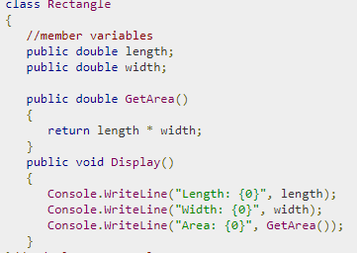
Public Access Specifier
Public access specifier allows a class to expose its member variables and member functions to other functions and objects.

Slide 31
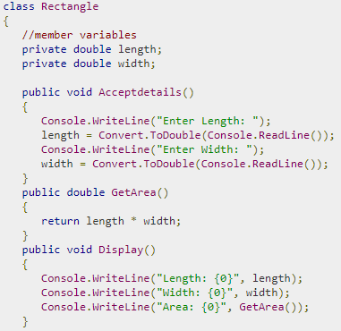
Private Access Specifier
Private access specifier allows a class to hide its member variables and member functions from other functions and objects. Only functions of the same class can access its private members. Even an instance of a class cannot access its private members.

Slide 32
Protected Access Specifier
Protected access specifier allows a child class to access the member variables and member functions of its base class. This way it helps in implementing inheritance.

Slide 33
Inheritance
Inheritance is one of the fundamental attributes of object-oriented programming. It allows you to define a child class that reuses ,extends, or modifies the behavior of a parent class.
C# and .NET core support single inheritance only.
Private members can’t be used in derived classes.
Protected members are visible only in derived classes.
Public members are visible everywhere.

Slide 34
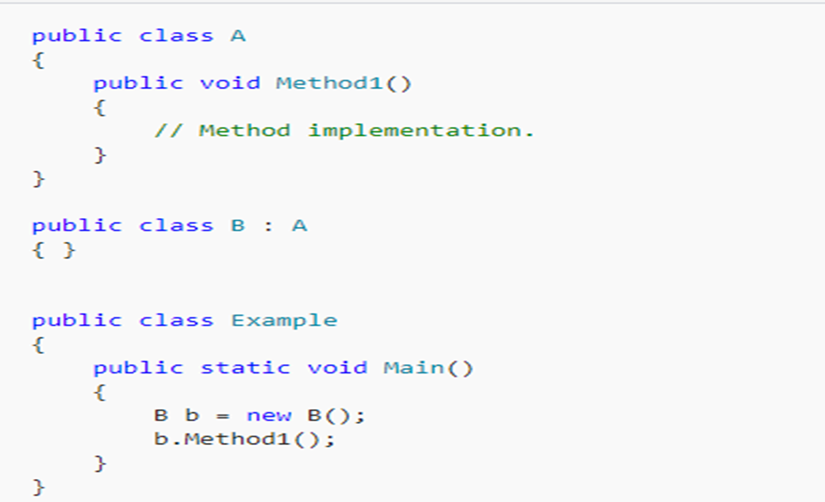

Slide 35
Array and Collections; Inheritance Prevention
-Vikash

Slide 36
Arrays and Collections
Arrays:
An array is an indexed collection of objects Arrays are collections of objects of the same type. Arrays can be almost any length, they can be used to store thousands or even millions of objects, but the size must be decided when the array is created. Each item in the array is accessed by an index, which is just a number that indicates the position or slot where the object is stored in the array. Arrays can be used to store both Reference Types and Value Types.

Slide 37
Arrays and Collections
Single-Dimensional Arrays:
A single-dimensional array of objects is declared like this:
type[] arrayName;
int[] array = new int[5];
int[] array1 = new int[] { 1, 3, 5, 7, 9 };

Slide 38
Arrays and Collections
Multidimensional Arrays:
A multidimensional array with two dimensions resembles a grid. A multidimensional array with three dimensions resembles a cube.
// To declare multidimension array (two dimensions)
int[,] array2D = new int[2,3];
// To declare and initialize multidimension array
int[,] array2D2 = { {1, 2, 3}, {4, 5, 6} };

Slide 39
Arrays and Collections
// To write elements in a multidimensional array
for (int i=0; i<2; i++)
{
for (int j=0; j<3; j++)
{
array2D[i,j] = (i + 1) * (j + 1);
}
}

Slide 40
Arrays and Collections
// To read elements in a multidimensional array
for (int i=0; i<2; i++)
{
for (int j=0; j<3; j++)
{
System.Console.Write(array2D[i,j]);
}
System.Console.WriteLine();
}

Slide 41
Arrays and Collections
Collections:
An array is just one of many options for storing sets of data by using C#. The option that you select depends on several factors, such as how you intend to manipulate or access the items. For example, a list is generally faster than an array if you must insert items at the beginning or in the middle of the collection. Other types of collection classes include map, tree, and stack; each one has its own advantages.

Slide 42
Arrays and Collections
public class TestCollections
{
public static void TestList()
{
List<string>sandwich=newList<string>();
sandwich.Add("bacon"); sandwich.Add("tomato");
sandwich.Insert(1, "lettuce");
foreach (string ingredient in sandwich) {
System.Console.WriteLine(ingredient);
}
}
}
// Output:
// bacon
// lettuce
// tomato

Slide 43
Sealed keyword
The sealed keyword enables to prevent the inheritance of a class .
Classes can be declared as sealed by putting the keyword sealed before the class definition. For example:
public sealed class D
{
// Class members here.
}

Slide 44
Sealed Classes
A sealed class cannot be used as a base class. Sealed classes prevent derivation. Because they can never be used as a base class, some run-time optimizations can make calling sealed class members slightly faster.
A method, property, or event, on a derived class that is overriding a virtual member of the base class can declare that member as sealed. This negates the virtual aspect of the member for any further derived class. This is accomplished by putting the sealed keyword before the override keyword in the class member declaration.

Slide 45
Sealed Classes
Example:
public class D : C
{
public sealed override void
DoWork() { }
}

Slide 46
Sealed Classes
using System;
interface ITest { int GetNumber(); }
class TestA : ITest
{
public int GetNumber() { return 1; }
}
sealed class TestB : ITest
{
public int GetNumber() { return 2; }
}
class Program
{
static void Main()
{
ITest test1 = new TestA(); // Regular class
ITest test2 = new TestB(); // Sealed instantiation Console.WriteLine(test1.GetNumber()); // TestA.GetNumber Console.WriteLine(test2.GetNumber()); // TestB.GetNumber
}
Output: 1 2

Slide 47
Sealed keyword on improving performance of method calls
For interface-heavy programs, the sealed decoration can result in a speedup on all method calls with no downside.
Outer variables used in benchmark
int sum1 = 0; int sum2 = 0;
ITest test1 = new TestA();
ITest test2 = new TestB();

Slide 48
Sealed keyword on improving performance of method calls
Contents of tight loops
sum1 += test1.GetNumber(); // Loop 1 body
sum1 += test1.GetNumber();
sum1 += test1.GetNumber();
sum1 += test1.GetNumber();
sum1 += test1.GetNumber();
sum2 += test2.GetNumber(); // Loop 2 body
sum2 += test2.GetNumber();
sum2 += test2.GetNumber();
sum2 += test2.GetNumber();
sum2 += test2.GetNumber();

Slide 49
Sealed keyword on improving performance of method calls
Results
Iterations: 100
TestA.GetNumber (regular): 2.490 ns
TestB.GetNumber (sealed): 2.162 ns [faster]

Slide 50
Differences between a Class and a Structure
-Sneha

Slide 51
Struct is a value type whereas class is a reference type
Structs are stored on stack, classes are stored in heap
Value type hold their value in memory where they are declared, but reference types hold a reference to an object in memory.
Value types are destroyed immediately after the scope is lost, whereas in the reference type, the reference variable is destroyed after the scope is lost.

Slide 52
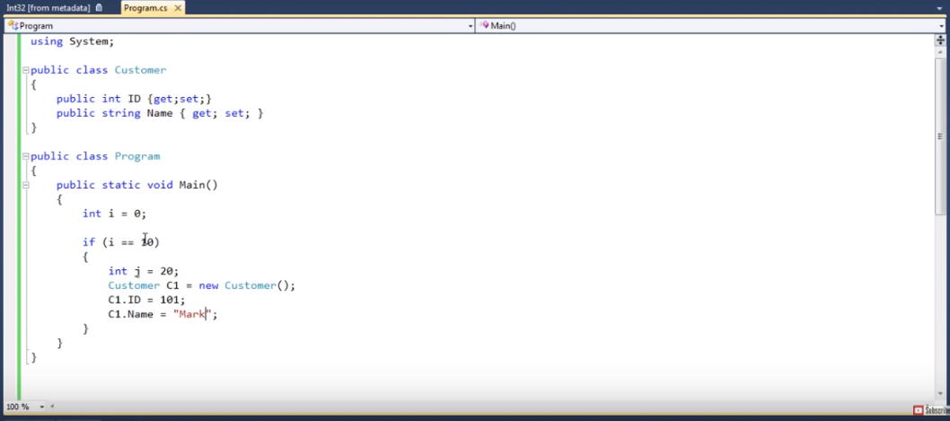

Slide 53
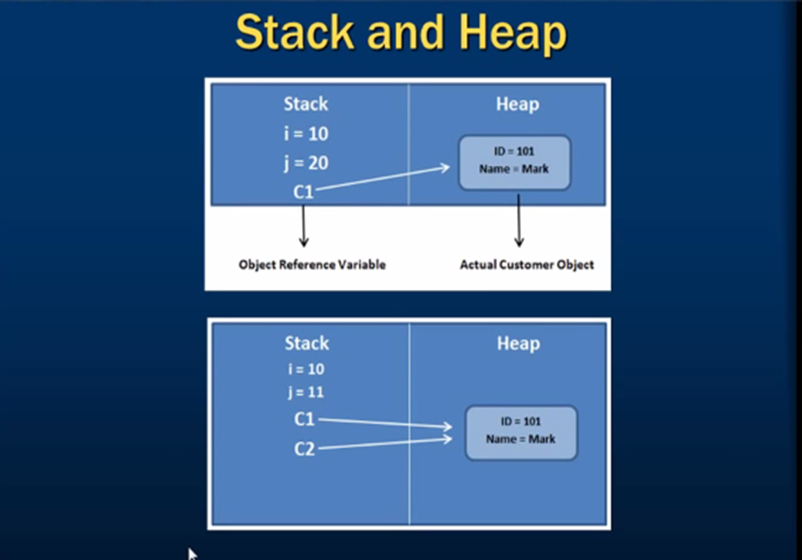

Slide 54
When you copy a struct into another struct, a new copy of that struct gets created & modifications on one struct will not affect the values contained in the other struct.
When you copy a class into another class, only a new copy of the reference gets created . So operations on one class will affect the values contained in the other class.

Slide 55
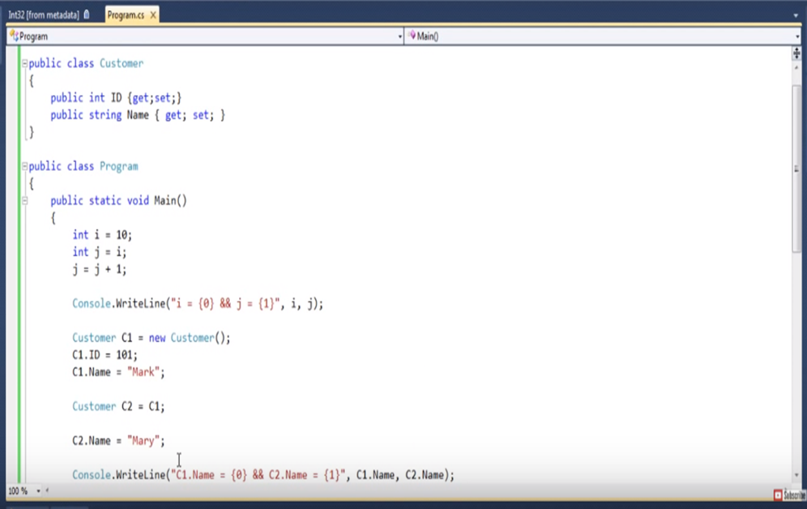

Slide 56


Slide 57
Structs cannot have destructors, whereas classes can
Structs cannot have explicit parameter less constructors whereas a class can
Structs cannot inherit from another class whereas a class can. Both can inherit from an interface.

Slide 58
Does .NET support multiple inheritance
-Sneha

Slide 59
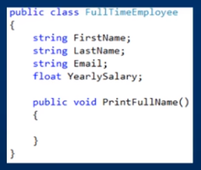
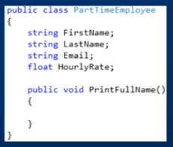

Slide 60
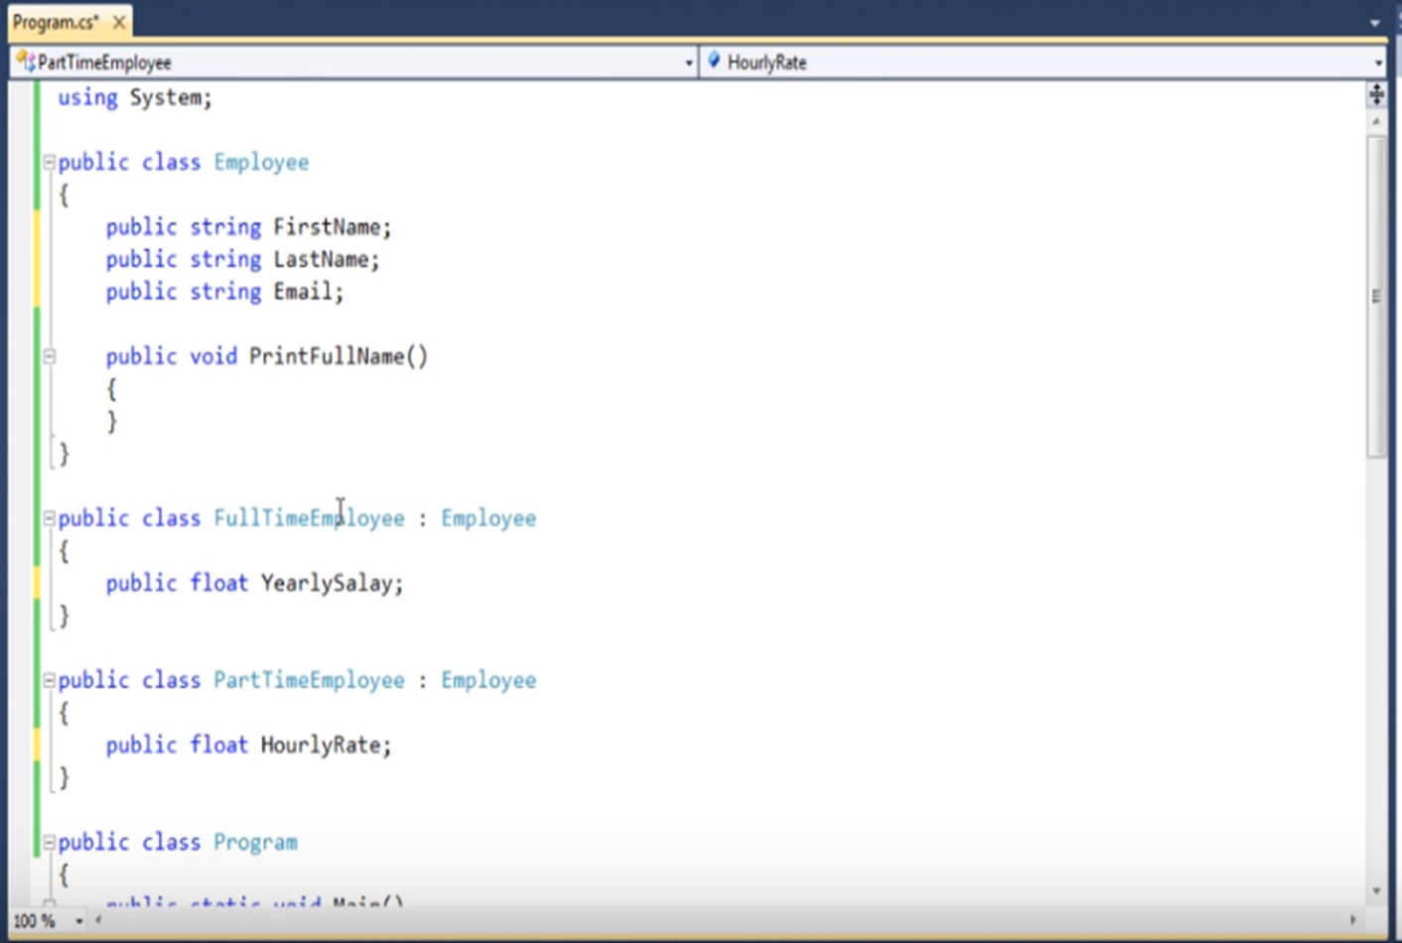

Slide 61
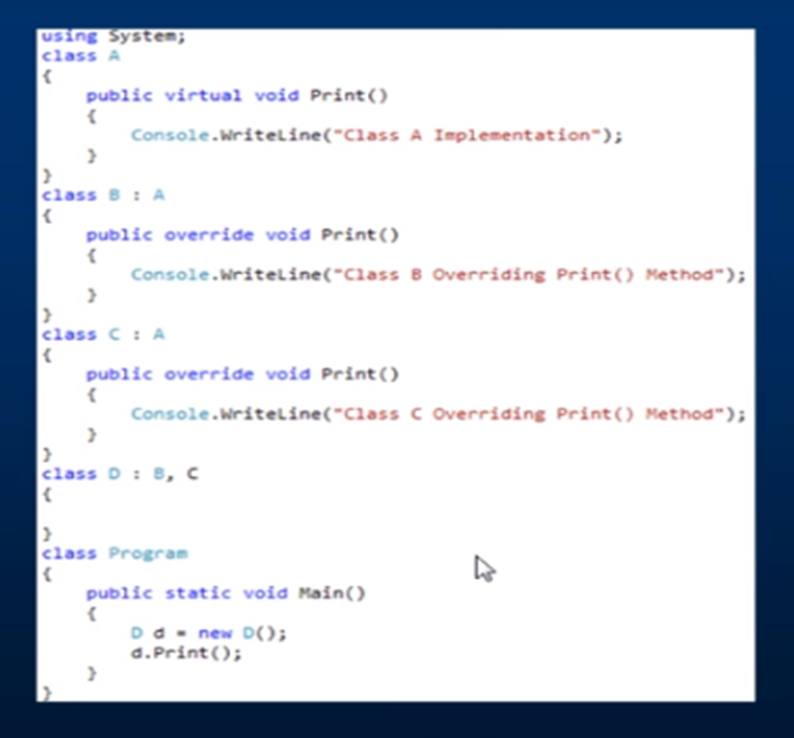

Slide 62
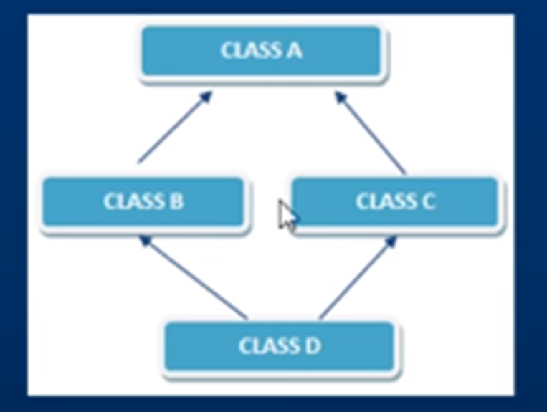

Slide 63
Access Modifiers and Strings
-Arindam

Slide 64
Access Modifiers for Methods and their Usage
Access Modifiers are some reserved keywords in C# which specify the accessibility of any method or data type.
They are of 4 types in C#:
public
private
protected
internal
protected internal

Slide 65
Access Modifiers for Methods and their Usage
public:
making a method public we can access the same outside the class where it belongs.
It can also be accessed by another namespace provided the namespace having the method is imported.
Basically a public method can be invoked everywhere.

Slide 66
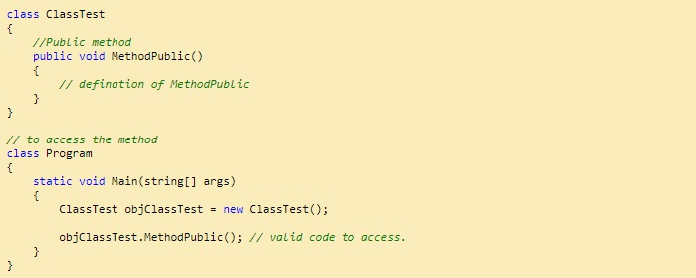
Access Modifiers for Methods and their Usage
public: Code snippet:

Slide 67
Access Modifiers for Methods and their Usage
private:
It restricts the accessibility of a particular method.
If declared private, it can only be accessed inside the class.
Any attempt trying so will result in errors.

Slide 68
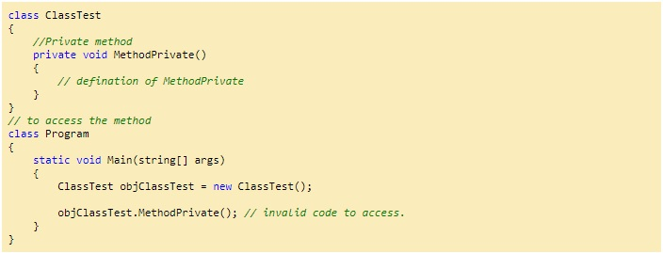
Access Modifiers for Methods and their Usage
private: Code snippet:

Slide 69
Access Modifiers for Methods and their Usage
protected:
It restricts the accessibility of the methods declared in a class within the same class and its subclasses; i.e. the ones inheriting the class.
Basically private methods have accessibility only to the same class and the classes inheriting it.

Slide 70
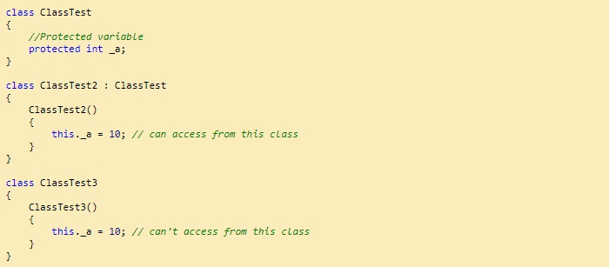
Access Modifiers for Methods and their Usage
protected: Code snippet:

Slide 71
Access Modifiers for Methods and their Usage
internal:
It provides the accessibility throughout an assembly.
An assembly can contain a number of namespaces.
If declared it can be accessed across the assembly anywhere but not outside.

Slide 72
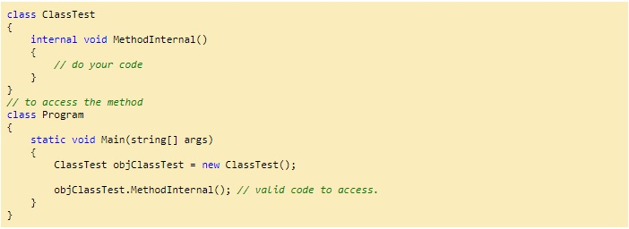
Access Modifiers for Methods and their Usage
internal: Code snippet:

Slide 73
Access Modifiers for Methods and their Usage
protected internal:
Almost similar to internal.
A method has accessibility among the entire assembly .
Additionally, it also provides the accessibility to only the subclasses inheriting the class even if they are in some other assembly.

Slide 74
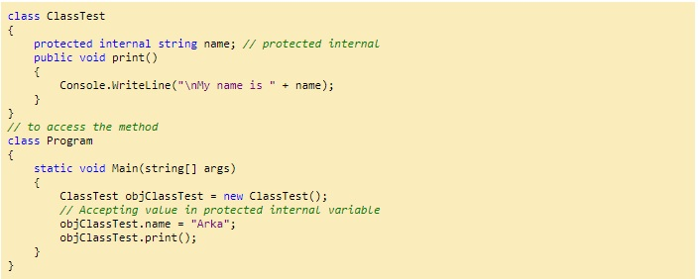
Access Modifiers for Methods and their Usage
protected internal: Code snippet:

Slide 75
Strings: Mutability
A “string” is an object of the type “String” whose value is of type text.
In C# when we say “string” it is an alias for “String” so we can use any of them it doesn’t matter.
So, “String” is rather a class and not a data type and internally the “String” objects are stored as a collection of “char” types.

Slide 76
Strings: Mutability
Strings are immutable: meaning they cannot be changed once they are created.
Whenever any method happens to make any changes to string objects, new objects are created simply releasing the reference to the old object. The garbage collector clears it.
Basically String modification is String creation

Slide 77
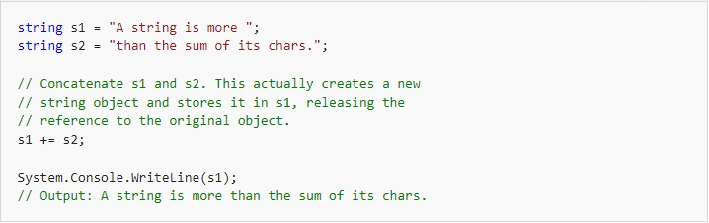
Strings: Mutability
Code Snippet:

Slide 78
Thank You!

